Slide 1


Microhistological Analysis of the Dietary Habits of Sheep: GrazeView AI
Godson Edewor, Arnav Gokhale, Jack Nelson, and Nate Scott

Slide 2
Project Description
Problem Statement:
TAMU AgriLife is currently investigating the Dietary Habits of Sheep and the effect it has on their wool.
This can be a very time consuming effort, when analyzing microscopic samples by hand.

Slide 3
Project Description
Solution Proposal:
GrazeView AI will allow the process of analyzing these microscope slides to become automated.
This will save TAMU AgriLife both time and money spent in training individuals that analyze by hand.

Slide 4
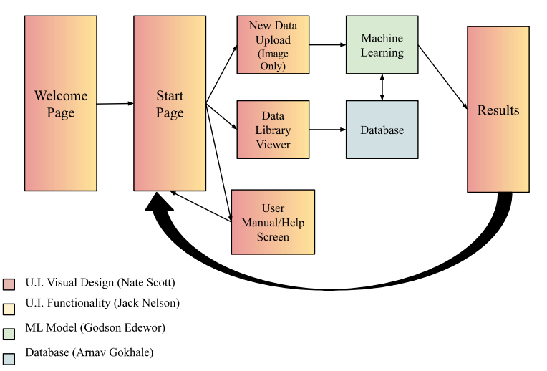
System Overview

Slide 5
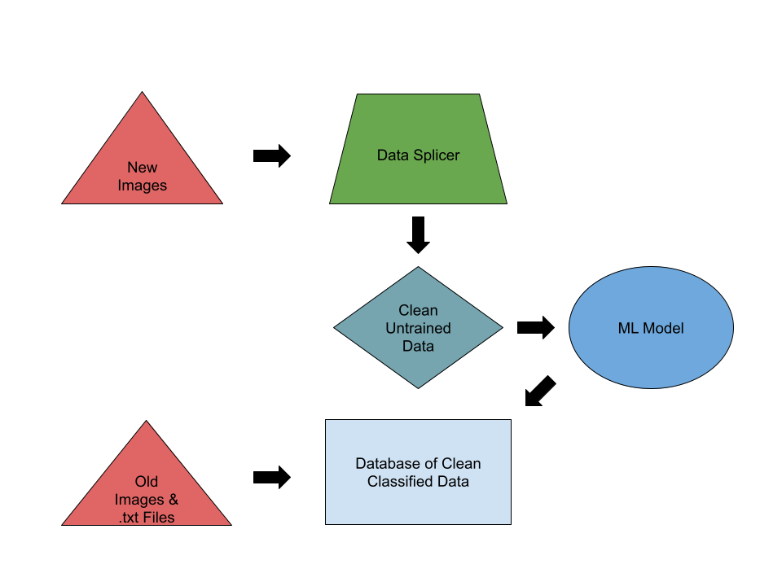
Database
Arnav Gokhale
Dataset Management: Manages training, validation, and test datasets, ensuring the machine learning model is trained on accurate, well-labeled data.
Automation of Data Pipelines: Builds automated pipelines for data collection, preprocessing, and feeding into the machine learning model, reducing manual intervention.
Collaboration with ML Model: Works closely with the machine learning model to optimize predictions.
Data Preprocessing: Prepares
and cleans raw data
(microscopic images) for accurate
analysis by the Machine
Learning model.

Slide 6
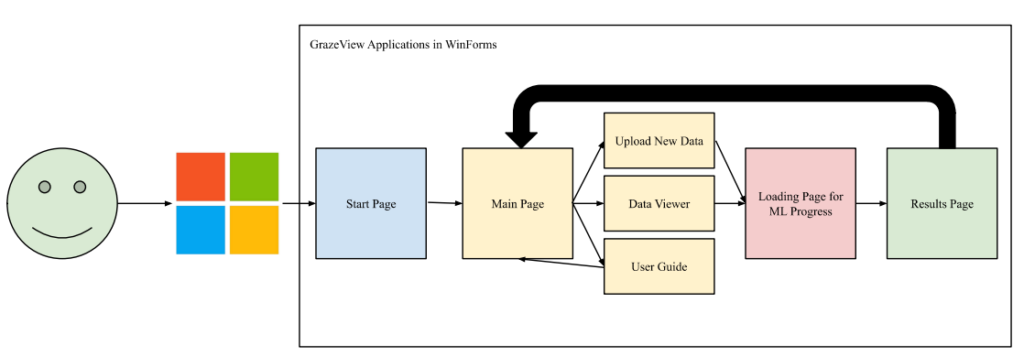
User Interface - Functionality
Jack Nelson
Allows users to upload images from file explorer to be analyzed by the Machine Learning Model
Provides real-time updates on ML Progress
Provides Results in a viewer-friendly fashion
Application is designed to be easily used, without any prior knowledge needed

Slide 7
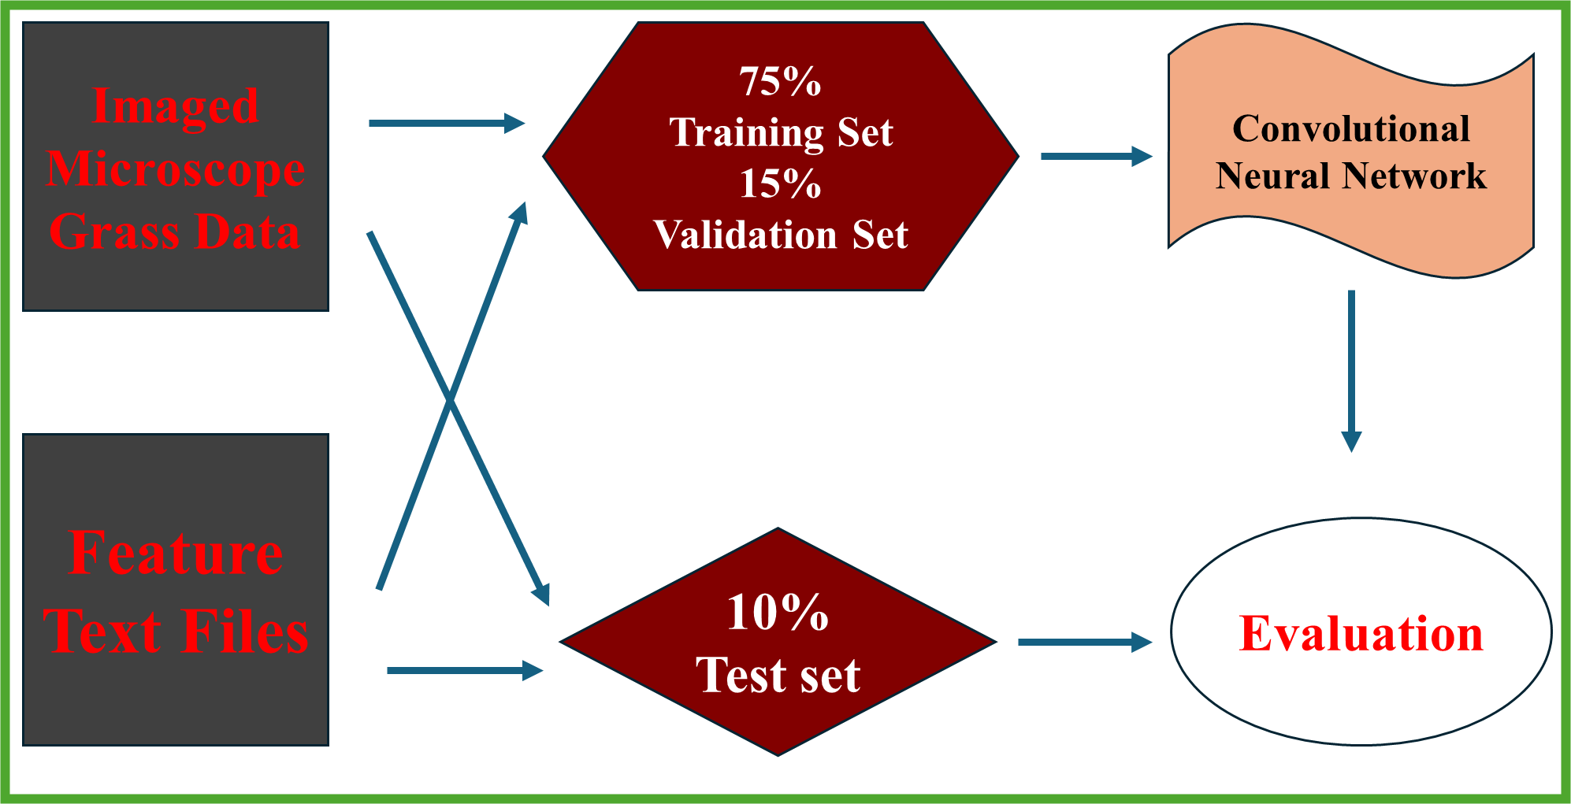
Machine Learning Model
Godson Edewor
Five Feature Convolutional Neural Network
Trained on 4k HD sheep microscopic fecal data
TensorFlow ML model library to analyze the training, validation, and testing dataset
80% Comprehension Goal

Slide 8

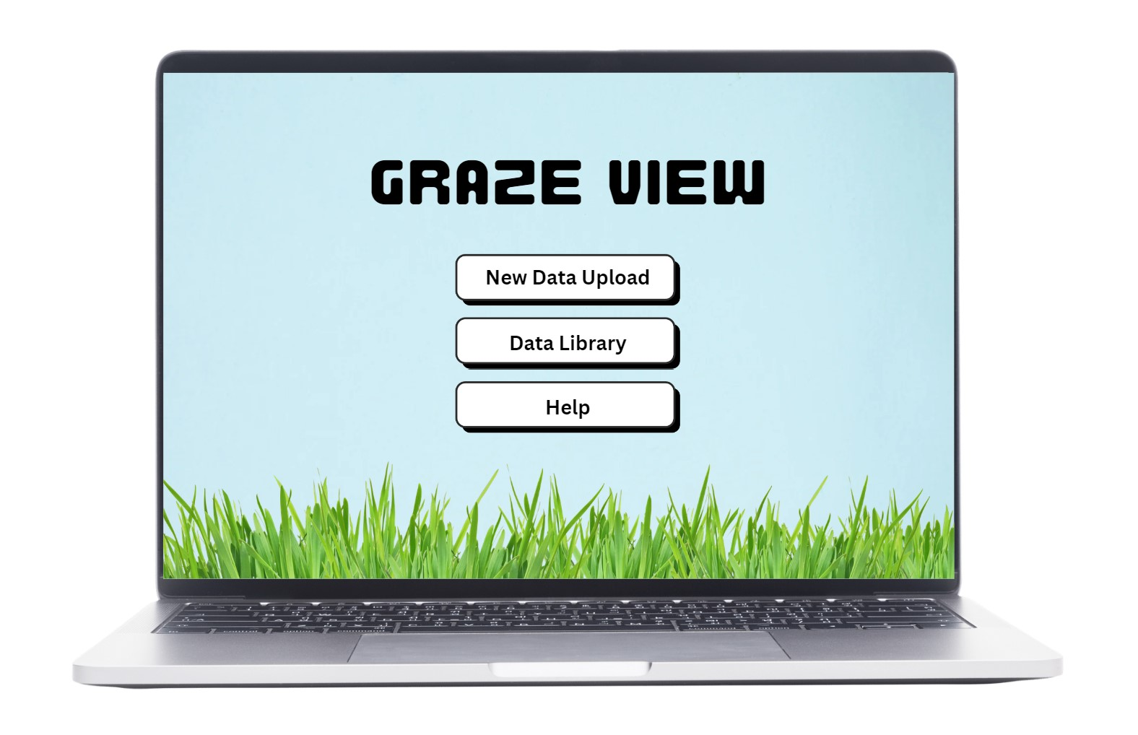


User Interface - Visual Design
Nate Scott
Provides the user a professional, well-organized interface, reducing distractions and increasing ease of use.
Establishes a unique identity and reinforces the application’s purpose.
Creates an accessible interface for any user.
Displays results and information in a clear and user-friendly manner.

Slide 9
Execution and Validation
 | Oct. 2nd | Oct. 16th | Oct. 30th | Nov. 13th | Nov. 26th
ML Model (Godson) | Five Feature CNN model | Feature Testing | 50% Neural Net | Feature Validation | Output Testing
Data Science (Arnav) | Classify Data Sets (Grass & Image) | Image Splicer 50% | Automate New Data Entry to DB, Image Splicer Complete | SQL Implementation complete | Refine & Test for bugs (DB)
User Interface - Utility (Jack) | U.I. Pathflow Complete | Image Upload Complete | Results Page Complete | Loading Complete | Refine & Test for bugs
User Interface - Design (Nate) | User Manual Complete | Welcome Page 25% | Welcome Page 100% | Background Design Complete | Refine & Test for bugs

